Slide 1
Accumulated Stability Voting (ASV) Project
Fred Xu, Matthew Kim, Minh Quan
Yang, T.-Y., Lin, Y.-Y. & Chuang, Y.-Y., “Accumulated Stability Voting: A Robust Descriptor from Descriptors of Multiple Scales,” in Proc. IEEE Conf. on Computer Vision and Pattern Recognition (CVPR), Las Vegas, NV, USA, Jun.–Jul. 2016, pp. 327-335. doi:10.1109/CVPR.2016.42.

Slide 2
ASV Project
Goals:
Implement the ASV framework in C++ for future integration with OpenCV.
Evaluate ASV on the Oxford dataset.
Compare w/ SIFT, BRISK, & ORB
Feature extraction performance
C++ Implementation:
Multiscale feature extraction
Multiple 1st stage thresholding
Multiple 2nd stage thresholding
Generate real-valued and binary ASV descriptor

Slide 3
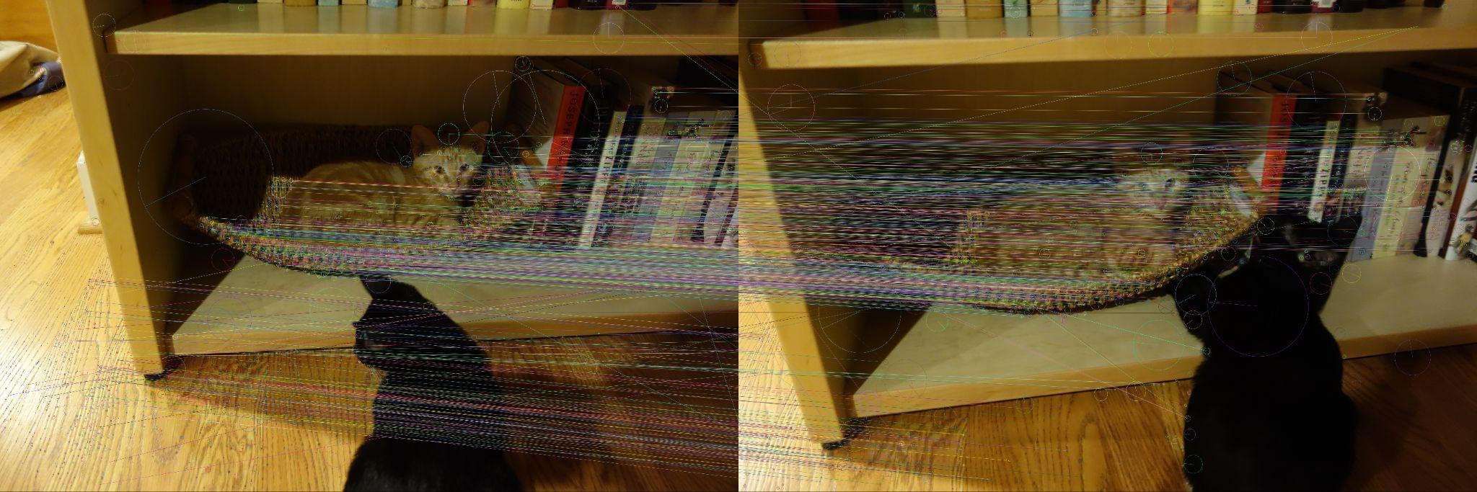
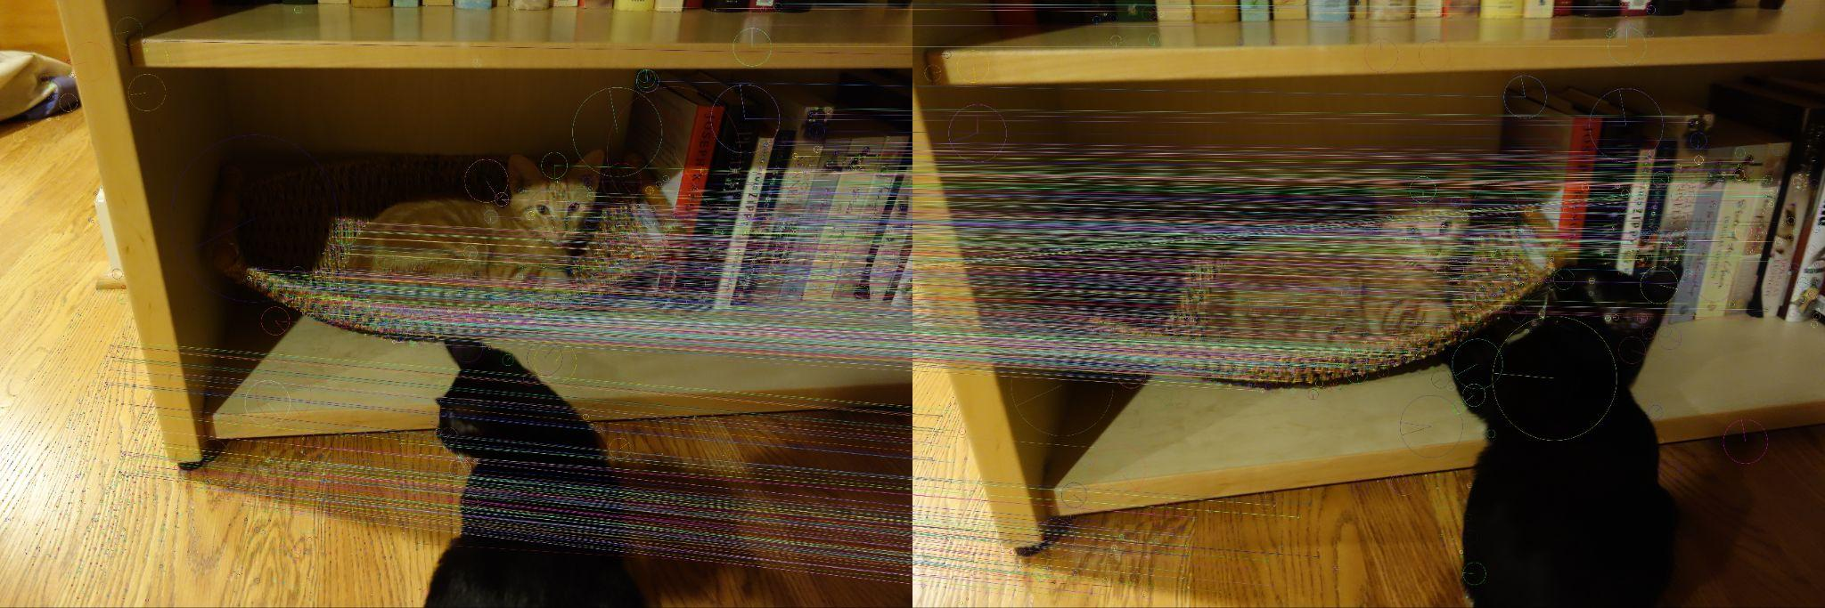
Feature Matching
SIFT
ASV-SIFT

Slide 4
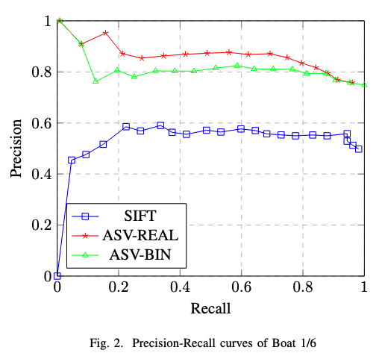
Results - Performance
mAP
Oxford Dataset
Binary Descriptors:
ASV-REAL > SIFT
Real-value Descriptors:
ASV-BINARY > BRISK > ORB
Precision-Recall
PR curve for Boat 1|6
(highest level of rotation/scale changes)
 | mAP
SIFT | 0.3391
ASV-REAL | 0.3883
BRISK | 0.1588
ORB | 0.1851
ASV-BINARY | 0.3034

Slide 5
Results - Performance
Descriptor Size
Feature Extraction Time
 | size | type
SIFT | 128 | float32
ASV-REAL | 128 x nt1 | float32
BRISK | 64 | binary
ORB | 32 | binary
ASV-BINARY | 128 x nt2 | binary
 | Time (ms)
SIFT | 250
ASV-REAL | 12,334
BRISK | 822
ORB | 47
ASV-BINARY | 11,396
*nt = nThreshold1 | 2
Notes:
ASV generally descriptor size is bigger (drastically more in the ASV-real with 128 * 3 threshold and float32 type) => 1500 bytes and 128 * 3 = 384 for ASV-binary. The extraction time is visibly increased by around 50x while

Slide 6
Conclusion
C++ Implementation
Default ASV-SIFT
Future optimization related to vector/Mat usage
Matches author’s work
ASV-SIFT is an improvement over SIFT
requires more computation and resources
Future Work
Complete integration with OpenCV library
Further optimization
Multi-scaling implementation in other feature descriptors

